Slide 1

Machine Learning for portfolio analysis
Part 1
Mike Brewer

Slide 2
K-Means Clustering
+
Principal Component Analysis
Notes:
K-Means: iterative algorithm that tries to partition the dataset into Kpre-defined distinct non-overlapping subgroups (clusters) where each data point belongs to only one group. It tries to make the intra-cluster data points as similar as possible while also keeping the clusters as different (far) as possible. It assigns data points to a cluster such that the sum of the squared distance between the data points and the cluster’s centroid (arithmetic mean of all the data points that belong to that cluster) is at the minimum. The less variation we have within clusters, the more homogeneous (similar) the data points are within the same cluster.
Specify number of clusters K.
Initialize centroids by first shuffling the dataset and then randomly selecting K data points for the centroids without replacement.
Keep iterating until there is no change to the centroids. i.e assignment of data points to clusters isn’t changing.
Compute the sum of the squared distance between data points and all centroids.
Assign each data point to the closest cluster (centroid).
Compute the centroids for the clusters by taking the average of the all data points that belong to each cluster.
PCA: dimensionality reduction technique (not ML) used to transform a high-dimensional dataset into a lower-dimensional representation while preserving as much information as possible.

Slide 3
Is my portfolio diversified?
Portfolio diversification is typically judged on an industry/sector basis.
This categorical/nominal data is easily obtained and understood.
But what if we wanted to take a quantitative approach to classifying companies and identifying where risk is pooled?
How might we judge portfolio diversification based on choice quantitative data?

Slide 4
Motivation
This study provides a data mining-based classification scheme and compares it with traditional classification schemes (such as SIC/NAICS/GICS/FamaFrench)
Applies K-means clustering algorithm on financial ratios to identify companies with similar operating characteristics
Conclusion: clustering method leads to more cohesive groups than traditional classification schemes
http://raw.rutgers.edu/docs/wcars/40wcars/Presentations/KexingXuanYunsen.pdf

Slide 5
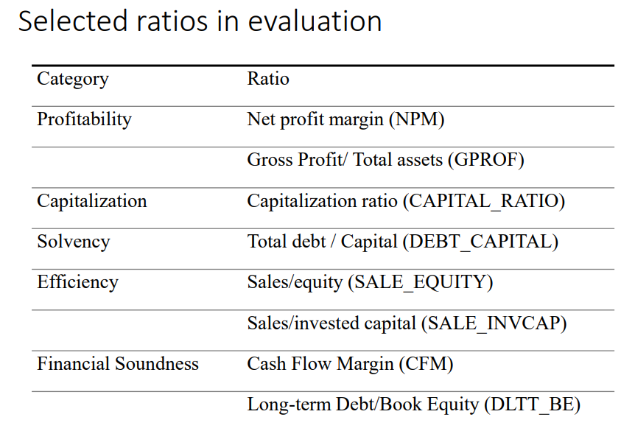

Slide 6
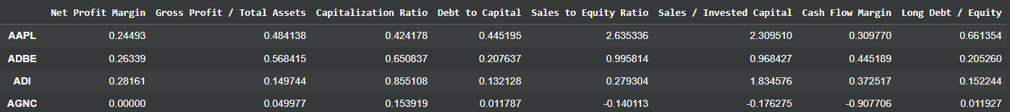
Step 1: Get Data
Step 2: Clean Data
Step 3: Standardize Data (to Z-Scores along choice distribution)
Step 4: Winsorize Data (bring outliers inward)

Slide 7
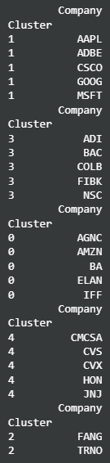
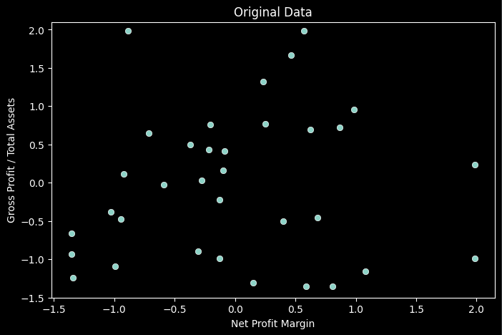
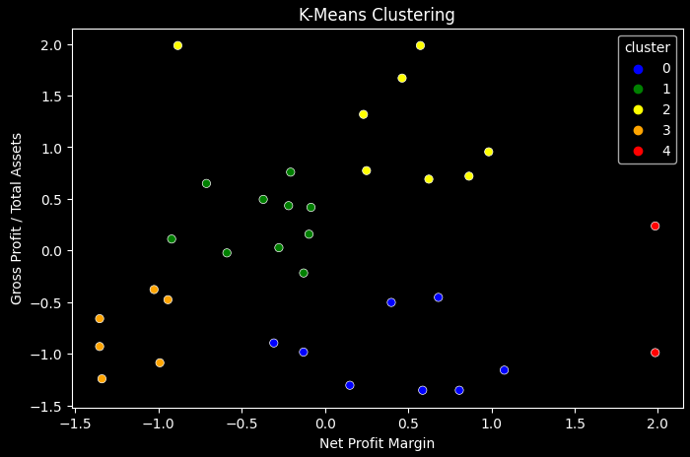
Simple 2D K-means Clustering

Slide 8
Does K-Means work for 3-Dimensional data? 8-Dimensional data? Yes, technically.
However, it is much better practice to apply Principal Component Analysis to reduce dimensionality before applying K-Means.
This alleviates the curse of dimensionality, enables feature selection/visualization, reduces noise and improves interpretability. PCA preserves as much data as possible!
Notes:
PCA: dimensionality reduction technique (not ML) used to transform a high-dimensional dataset into a lower-dimensional representation while preserving as much information as possible.

Slide 9
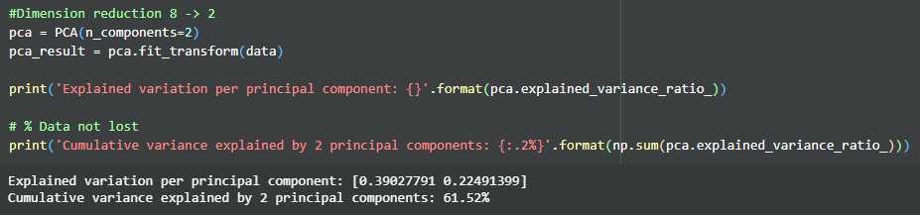
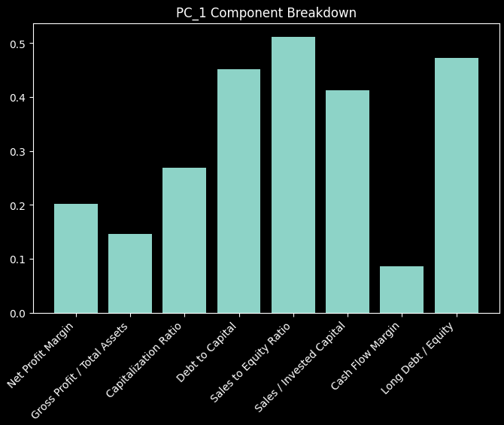
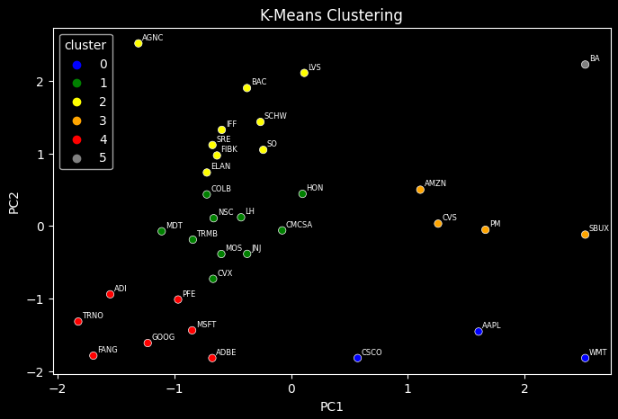
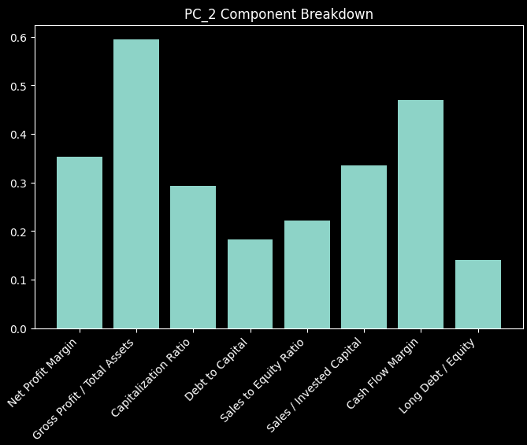
EI

Slide 10
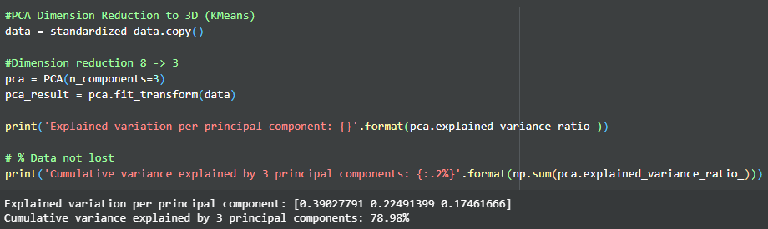
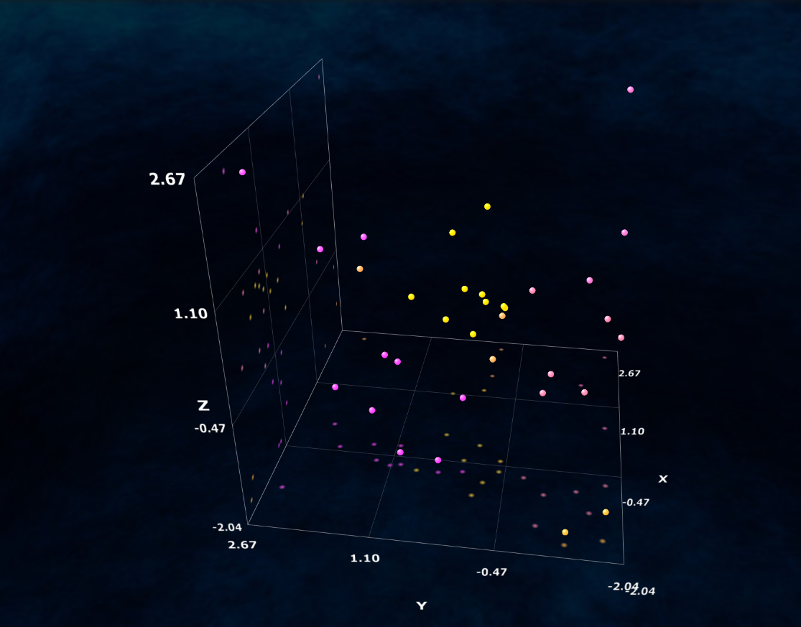
Notes:
Interactive
https://miabellaai.net/
EI
AAPL::1.605882398331176::-1.4571048587555124::-0.1605739069497752::22::13::1::1::0::0::0::0; ADBE::-0.6745299477274765::-1.827007642351682::0.3078501035551106::28::13::1::1::0::0::0::0; ADI::-1.5483205183619753::-0.9428795018033636::0.020736980196812423::28::13::1::1::0::0::0::0; AGNC::-1.3070536023531778::2.4534792816429767::2.4534792816429767::8::13::1::1::0::0::0::0; AMZN::1.1070427952457744::0.5002808207874812::0.7157816524160691::62::13::1::1::0::0::0::0; BA::2.4534792816429767::2.2269851591905163::-0.6897928812074913::42::13::1::1::0::0::0::0; BAC::-0.3772720623331637::1.9028160457075438::-1.0102177577948677::2::13::1::1::0::0::0::0; CMCSA::-0.075831633641244::-0.061185677716185105::0.4321492582844802::62::13::1::1::0::0::0::0; COLB::-0.7214930473263726::0.43508667763372677::-1.827007642351682::2::13::1::1::0::0::0::0; CSCO::0.570265926549923::-1.8223964424010894::1.1263094887220837::22::13::1::1::0::0::0::0; CVS::1.2591864001426214::0.032105409731653545::1.0756344785408571::62::13::1::1::0::0::0::0; CVX::-0.6675144436931753::-0.7295354212670953::0.8711118824418475::28::13::1::1::0::0::0::0; ELAN::-0.7209683564352368::0.7373924600928292::0.6965011433809047::62::13::1::1::0::0::0::0; FANG::-1.6926105154866675::-1.788679681160353::-1.562166738835289::48::13::1::1::0::0::0::0; FIBK::-0.6342868545189055::0.9727449615726722::-1.827007642351682::2::13::1::1::0::0::0::0; GOOG::-1.2271856189606645::-1.615230527736849::0.8830841999875673::28::13::1::1::0::0::0::0; HON::0.09813334175683398::0.44302263566023264::-0.0909687656266242::62::13::1::1::0::0::0::0; IFF::-0.5929719984366505::1.3257400454213435::1.4061137189742656::8::13::1::1::0::0::0::0; JNJ::-0.37582171848539303::-0.38505357046105937::0.43152205173177294::62::13::1::1::0::0::0::0; LH::-0.428027370419946::0.11929337777075603::0.6944417804082978::62::13::1::1::0::0::0::0; LVS::0.113351817881305::2.1112051777114766::0.8364534218241029::8::13::1::1::0::0::0::0; MDT::-1.107715340181715::-0.07338561281282607::0.4707714626309373::62::13::1::1::0::0::0::0; MOS::-0.5970408261409677::-0.3865789029870658::0.583387946856021::62::13::1::1::0::0::0::0; MSFT::-0.8470166716108356::-1.4400510106795483::-0.419597832358493::28::13::1::1::0::0::0::0; NSC::-0.6629689338815157::0.10682644893317311::-0.7979607163795724::2::13::1::1::0::0::0::0; PFE::-0.9672313234928218::-1.0145453796792863::-0.10617015327849352::28::13::1::1::0::0::0::0; PM::1.6645215780746547::-0.052756457350167485::-1.7192614735588096::42::13::1::1::0::0::0::0; SBUX::2.4534792816429767::-0.11920071525498122::-1.3839241369986426::42::13::1::1::0::0::0::0; SCHW::-0.2619964647143361::1.435142611575992::-1.4391442574815596::2::13::1::1::0::0::0::0; SO::-0.2381971175627541::1.0504128920663807::-0.6054513133592577::2::13::1::1::0::0::0::0; SRE::-0.6729438668371951::1.1165519865862643::-0.21740310827413914::2::13::1::1::0::0::0::0; TRMB::-0.8410206588978113::-0.1888522036983234::0.7699093473911363::62::13::1::1::0::0::0::0; TRNO::-1.827007642351682::-1.3188457408772396::-1.827007642351682::48::13::1::1::0::0::0::0; WMT::2.4534792816429767::-1.827007642351682::2.4534792816429767::22::13::1::1::0::0::0::0;

Slide 11
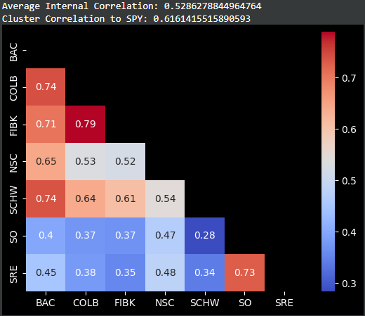
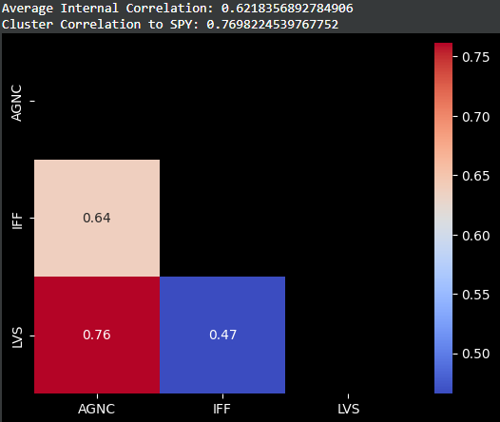
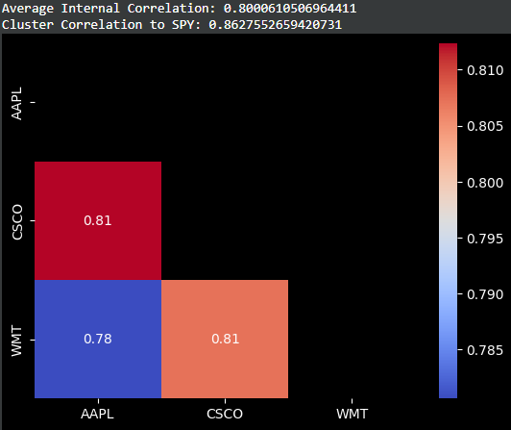
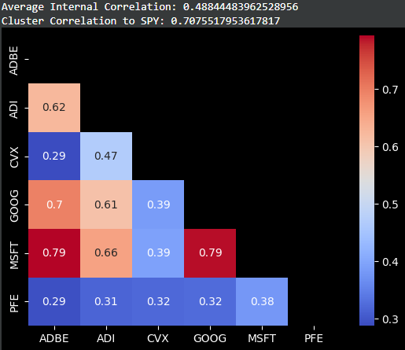
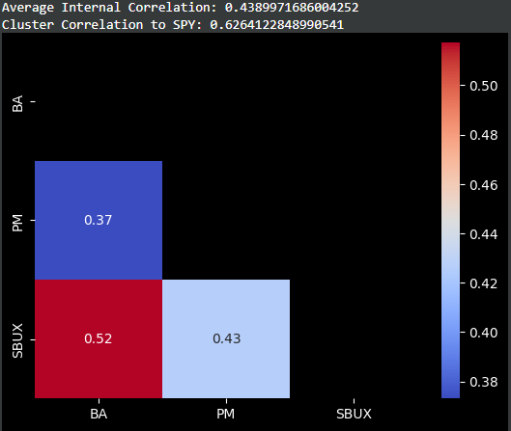
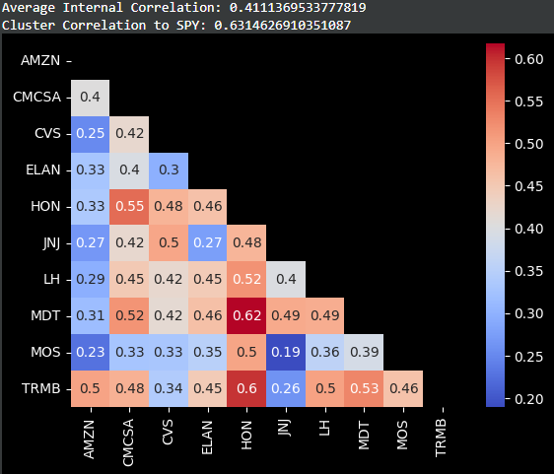
RETURNS

Slide 12
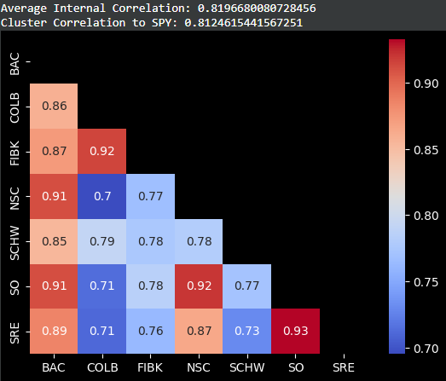


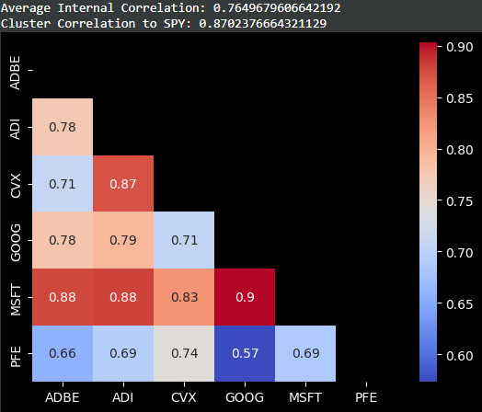
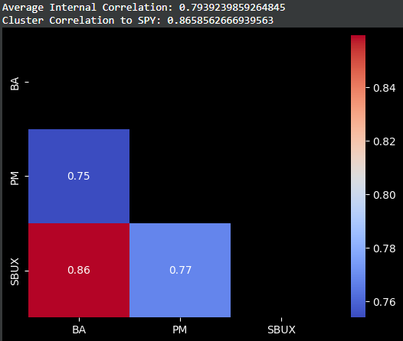
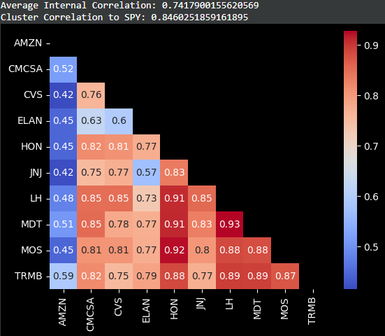
VOLATILITY
(std dev)

Slide 13
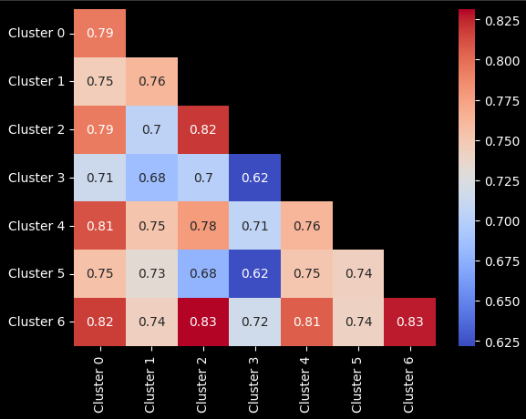
The diagonal line is each clusters average internal correlation. If our clusters have any categorical uniqueness for this volatility metric, we would expect internal correlations to be greater than that clusters correlation to any other cluster.
Not seeing any clear cut distinctions here!

Slide 14
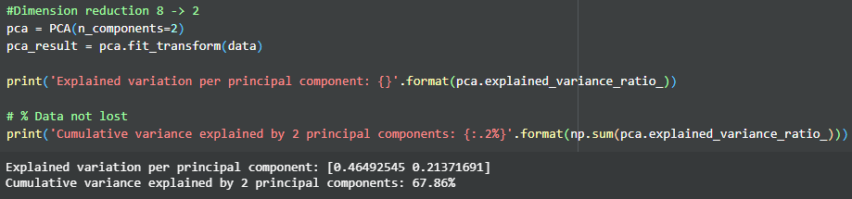
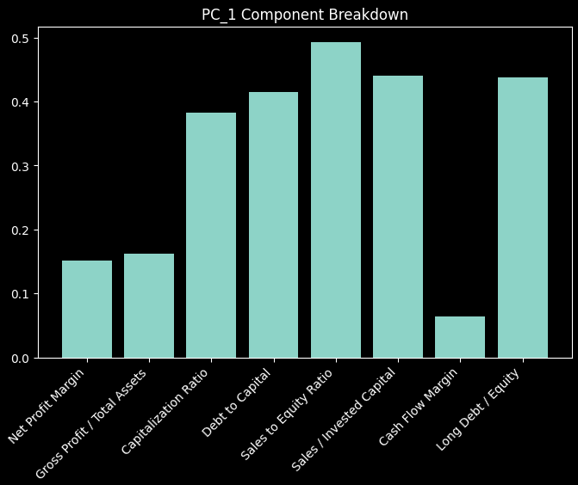
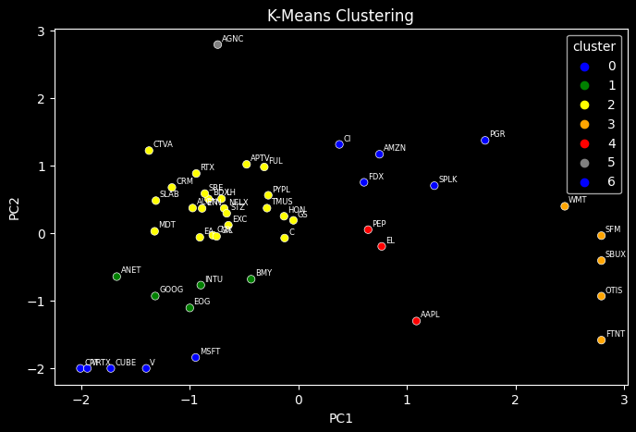
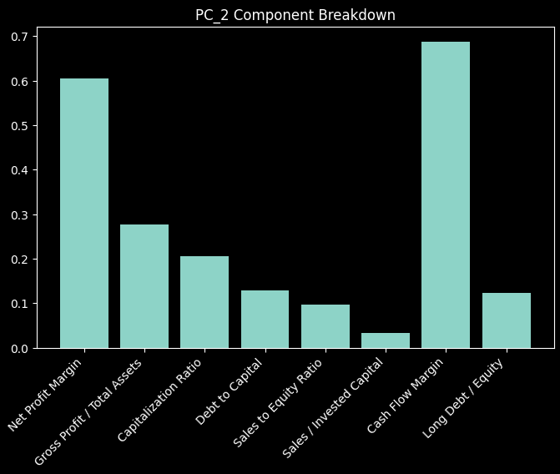
MCE

Slide 15
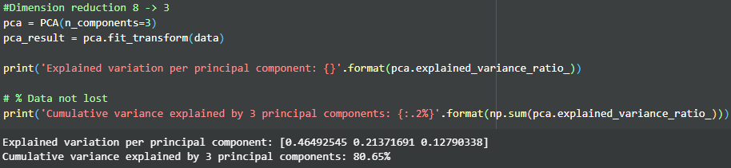
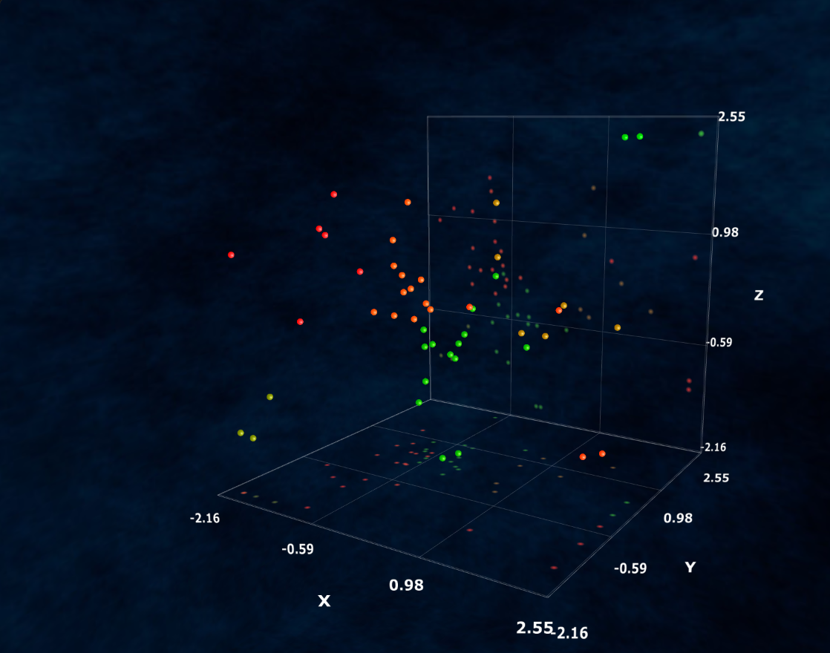
Notes:
AAPL::1.0880114218645178::-1.304645955691622::0.487389048424701::48::13::1::1::0::0::0::0; AGNC::-0.7416389402718694::2.3355836258029123::0.13125101712464304::8::13::1::1::0::0::0::0; ALGN::-0.9728119329184769::0.36989224188189423::1.4193772897250134::42::13::1::1::0::0::0::0; AMZN::0.7481018825545267::1.1667973253082062::-0.3956992515417098::28::13::1::1::0::0::0::0; ANET::-1.6713261392610395::-0.6462723592630618::1.1162829969244057::62::13::1::1::0::0::0::0; APTV::-0.4757301388620253::1.01711477947764::-0.49839622931343486::8::13::1::1::0::0::0::0; BDX::-0.8269935078835943::0.505820564722234::-0.3708189328574276::8::13::1::1::0::0::0::0; BMY::-0.43387159868201114::-0.6848897526966673::0.09760580220284651::42::13::1::1::0::0::0::0; C::-0.12594426338221515::-0.07515709756412736::-1.9419045677635254::8::13::1::1::0::0::0::0; CI::0.37834448381683716::1.3125793520580784::-0.6377473129613326::8::13::1::1::0::0::0::0; CPT::-1.9419045677635254::-1.9419045677635254::-1.3652815557459217::22::13::1::1::0::0::0::0; CRM::-1.1633221730616607::0.674242736668188::0.1526768890568204::42::13::1::1::0::0::0::0; CTVA::-1.3740692221867823::1.2206988462052668::0.1820985392345608::42::13::1::1::0::0::0::0; CUBE::-1.7258393632108526::-1.9419045677635254::-1.3939998495998804::22::13::1::1::0::0::0::0; CVX::-0.7868772913484986::-0.033477980869514465::0.4879206514830666::42::13::1::1::0::0::0::0; EA::-0.906084165951825::-0.06489684141275419::0.9536001224989441::42::13::1::1::0::0::0::0; EL::0.7683766611092478::-0.1986593698921586::1.5409433231847933::28::13::1::1::0::0::0::0; EOG::-0.9986857518731025::-1.1100832831592522::1.6283794048461484::62::13::1::1::0::0::0::0; ETN::-0.8855733675578974::0.36418927150071145::-0.1993611485731221::42::13::1::1::0::0::0::0; EXC::-0.6433177121853871::0.11465493103406525::-1.3007964519972375::8::13::1::1::0::0::0::0; FDX::0.6051675067829679::0.7509734118407981::-0.28930813852068976::28::13::1::1::0::0::0::0; FTNT::2.3355836258029123::-1.5876808804579914::0.6424749637028525::48::13::1::1::0::0::0::0; FUL::-0.31302493526333325::0.9781288134619771::-0.09691240150054753::8::13::1::1::0::0::0::0; GIL::-0.7523361080698825::-0.050641614445743284::0.26241709279902287::42::13::1::1::0::0::0::0; GOOG::-1.317117616248209::-0.9339884842963297::1.086375333224607::62::13::1::1::0::0::0::0; GS::-0.04478167361963533::0.18743187000056882::-1.9419045677635254::8::13::1::1::0::0::0::0; HON::-0.13094317530764932::0.2482007139828824::-0.6316769937754406::8::13::1::1::0::0::0::0; INTU::-0.8972553108976228::-0.7727898505282875::0.6323496554135427::62::13::1::1::0::0::0::0; LH::-0.7066050602972225::0.5062712651528158::-0.06712981226280125::42::13::1::1::0::0::0::0; MDT::-1.3224345385475806::0.024889080346844318::-0.08770098413972324::42::13::1::1::0::0::0::0; MSFT::-0.9448469855359101::-1.8446759395203651::0.17942274121891927::62::13::1::1::0::0::0::0; NFLX::-0.682535485473444::0.36470292044186625::0.04293769970067952::42::13::1::1::0::0::0::0; OTIS::2.3355836258029123::-0.9354450628855524::-1.1344274020518836::48::13::1::1::0::0::0::0; PEP::0.6432712913636482::0.04919713607532172::0.8365704812419196::28::13::1::1::0::0::0::0; PGR::1.7204393448006265::1.3723242455129128::-0.1951803788633177::28::13::1::1::0::0::0::0; PYPL::-0.27611930286821496::0.5589808638838706::-0.5099749211281662::8::13::1::1::0::0::0::0; RTX::-0.9395823740289263::0.8816010331724746::-0.677429178857209::8::13::1::1::0::0::0::0; SBUX::2.3355836258029123::-0.40917442894039785::-1.267324106943081::48::13::1::1::0::0::0::0; SFM::2.3355836258029123::-0.03945891853216881::2.3355836258029123::2::13::1::1::0::0::0::0; SLAB::-1.3112650561532564::0.479388221296523::0.49872179029893965::42::13::1::1::0::0::0::0; SPLK::1.2528805609095353::0.7014512587212168::0.17060091716986941::28::13::1::1::0::0::0::0; SRE::-0.8604075845551936::0.5840316757733727::-1.1502842519109595::8::13::1::1::0::0::0::0; STZ::-0.6590790273327828::0.29130262583487654::-0.5486446831637648::8::13::1::1::0::0::0::0; TMUS::-0.2880412810826669::0.36828851426182924::-0.6247828084240078::8::13::1::1::0::0::0::0; V::-1.40002912267173::-1.9419045677635254::-0.7990390820001326::22::13::1::1::0::0::0::0; VRTX::-1.9419045677635254::-1.9419045677635254::0.9109352334726142::62::13::1::1::0::0::0::0; WMT::2.3355836258029123::0.3957315796310722::2.3355836258029123::2::13::1::1::0::0::0::0;

Slide 16
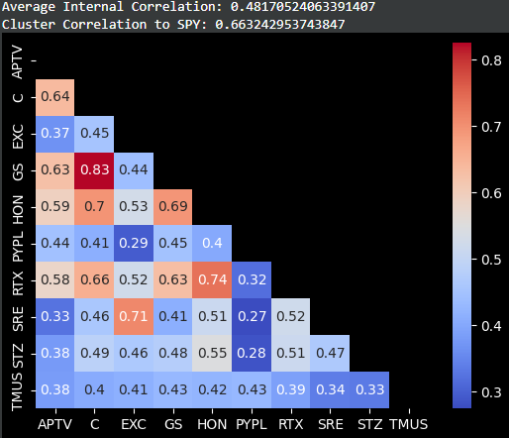
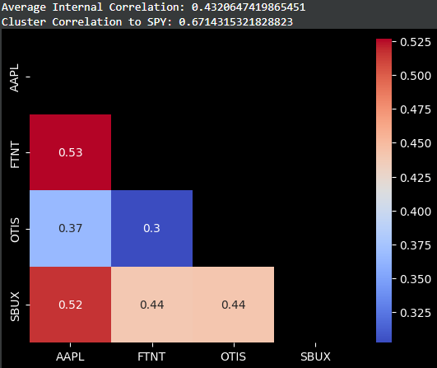
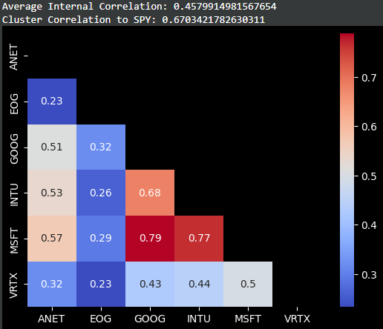
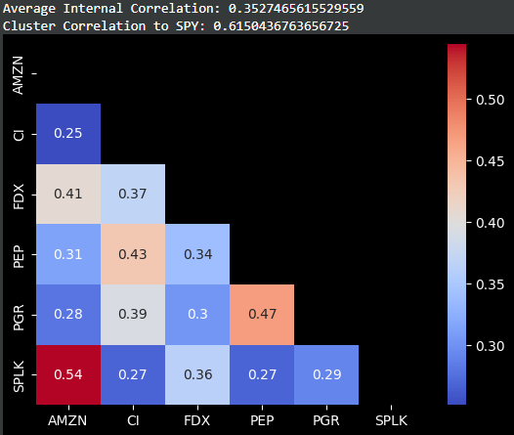
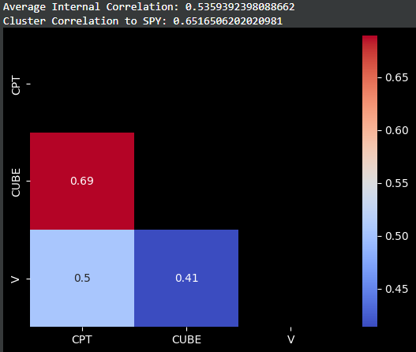
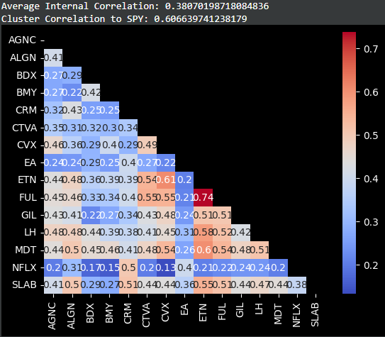
RETURNS

Slide 17
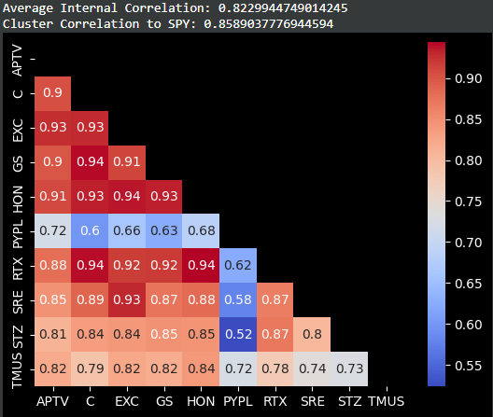
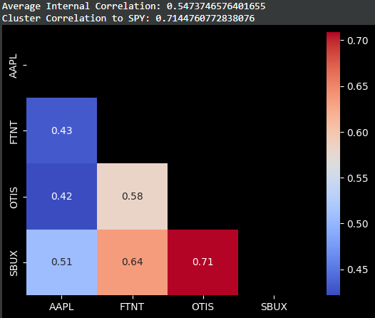
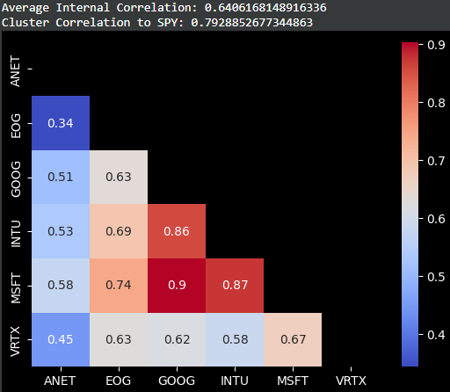
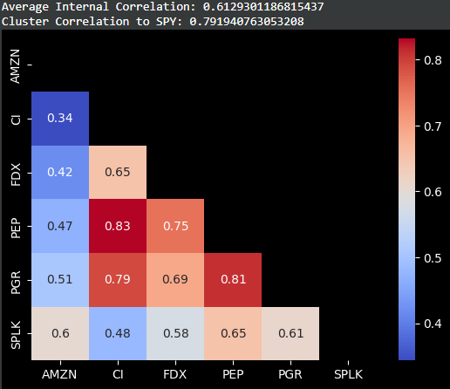
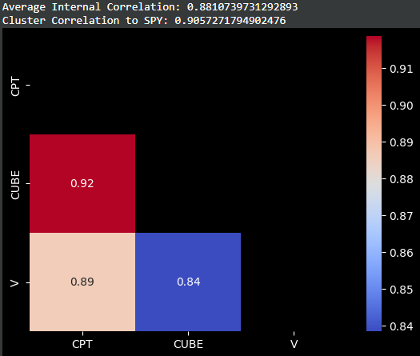
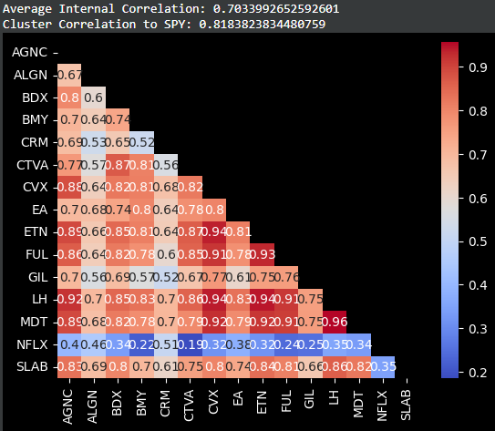
VOLATILITY
(std dev)

Slide 18
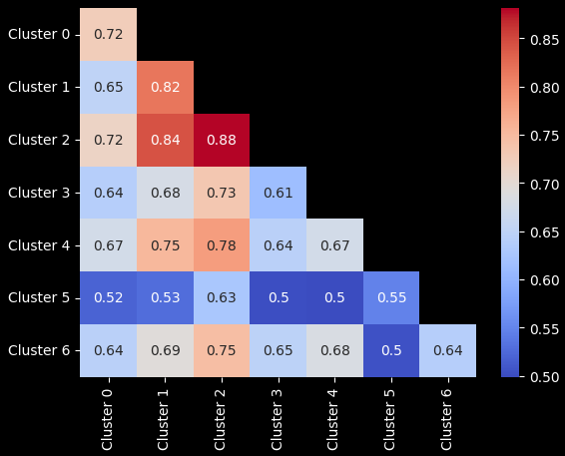
The diagonal line is each clusters average internal correlation. If our clusters have any categorical uniqueness for this volatility metric, we would expect internal correlations to be greater than that clusters correlation to any other cluster.
Nothing too extreme, though cluster 1 and 2 may be worth examining because their volatility is highly correlated and (somewhat) distinct from the rest of the clusters.

Slide 19
Things I didn’t do
Analyze clusters using different measures - we only looked at price & volatility (stdDev). We might consider examing other types of volatility (Parkinsons/GermanKlass/beta) or other risk measures (VaR/CVaR)
Pull data for entire S&P and apply PCA methods on same ratios, thus analyzing portfolio diversification within the broader universe of stocks.
Time-Series Cluster Analysis: Rutgers study only classified firms as peers if they fell in the same cluster for 5 consecutive years.

Slide 20
Future projects…
Natural Language Processing to cluster stocks based on descriptions
Risk Modeling and Management
Constructing/Backtesting Strategies & Portfolios (risk-adj or otherwise)
Brownian Price Simulation and Scenario Analysis
Forecasting

